Slide 1
Mirror and Lens Notes

Slide 2


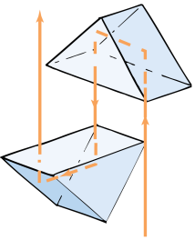
When waves interact with matter, they can be reflected, transmitted, or a combination of both. Waves that are transmitted can be refracted.

Slide 3

Reflection vs. Refraction
Light doesn’t travel through a mirror, but is returned by the mirror’s surface. These waves are reflected.
When waves strike the surface of a medium at an angle, their direction changes. These waves are refracted.

Slide 4
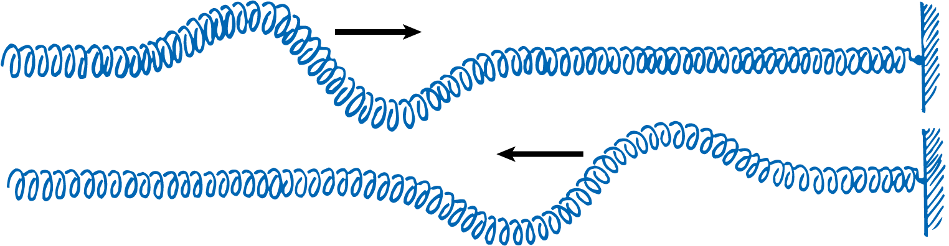
Reflection
When a wave reaches a boundary between two media, usually some or all of the wave bounces back into the first medium.
The return of a wave back to its original medium is called reflection.
Fasten a spring to a wall and send a pulse along the spring’s length.
The wall is a very rigid medium compared with the spring, so all the wave energy is reflected back along the spring.
Waves that travel along the spring are almost totally reflected at the wall.

Slide 5
Reflection
A metal surface is rigid to light waves that shine upon it.
Light energy does not propagate into the metal, but instead is returned in a reflected wave.
This is why metals such as silver and aluminum are so shiny. They reflect almost all the frequencies of visible light.

Slide 6
Reflection
Materials such as glass and water are not as rigid to light waves.
When light shines perpendicularly on the surface of still water, about 2% of its energy is reflected and the rest is transmitted.
When light strikes glass perpendicularly, about 4% of its energy is reflected.
Except for slight losses, the rest is transmitted.

Slide 7
The Law of Reflection
The law of reflection states that the angle of incidence and the angle of reflection are equal to each other.
In one dimension, reflected waves simply travel back in the direction from which they came.
In two dimensions, the situation is a little different.
The direction of incident and reflected waves is described by straight-line rays.

Slide 8
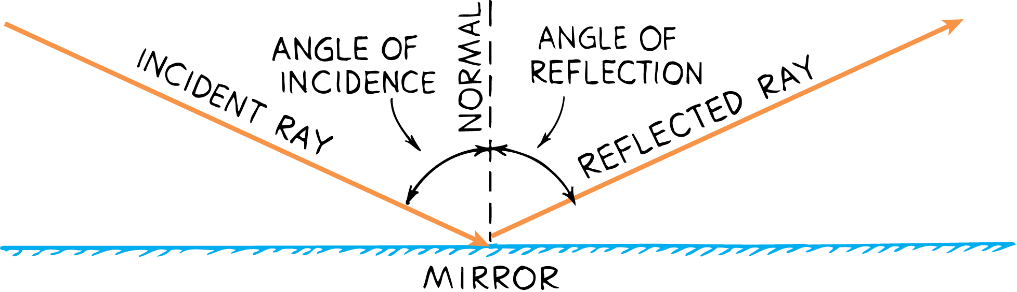
The Law of Reflection
Incident rays and reflected rays make equal angles with a line perpendicular to the surface, called the normal.
The angle between the incident ray and the normal is the angle of incidence.
The angle between the reflected ray and the normal is the angle of reflection.
Angle of incidence = Angle of reflection

Slide 9

Mirrors
Mirrors produce only virtual images.

Slide 10
Mirrors
If a candle flame is placed in front of a plane (flat) mirror, rays of light from the candle are reflected from the mirror in all directions.
Each of the infinite number of rays obeys the law of reflection.
The rays diverge (spread apart) from the tip of the flame, and continue diverging from the mirror upon reflection.
These divergent rays appear to originate from a point located behind the mirror.

Slide 11
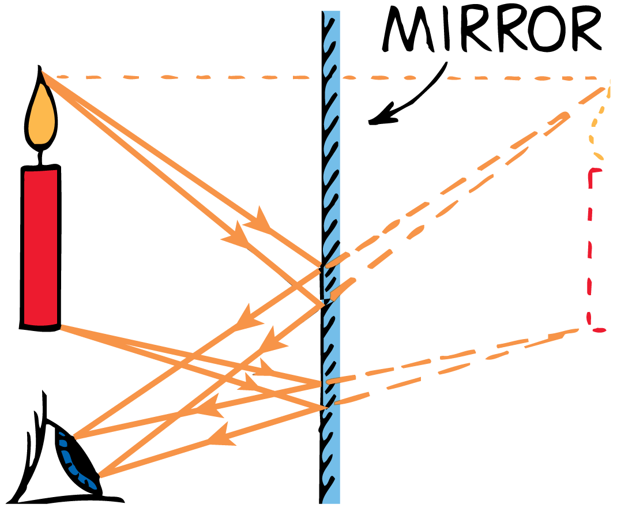
Mirrors
You perceive the candle flame to be located behind the mirror.
A virtual image appears to be in a location where light does not really reach.

Slide 12
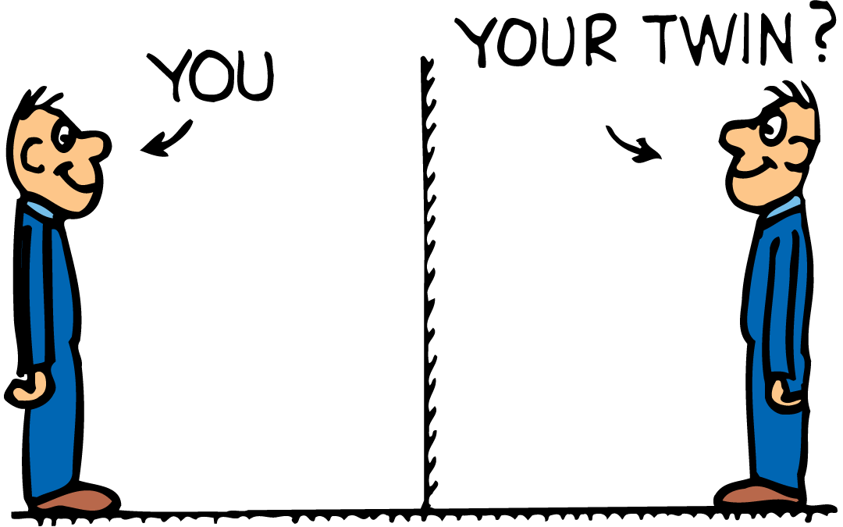
Mirrors
Your eye cannot ordinarily tell the difference between an object and its virtual image.
The light enters your eye in exactly the same manner as it would if there really were an object where you see the image.
The image is the same distance behind the mirror as the object is in front of it.
The image and object are the same size.

Slide 13
Refraction
When a wave that is traveling at an angle changes its speed upon crossing a boundary between two media, it bends.
Refraction is the bending of a wave as it crosses the boundary between two media at an angle.

Slide 14
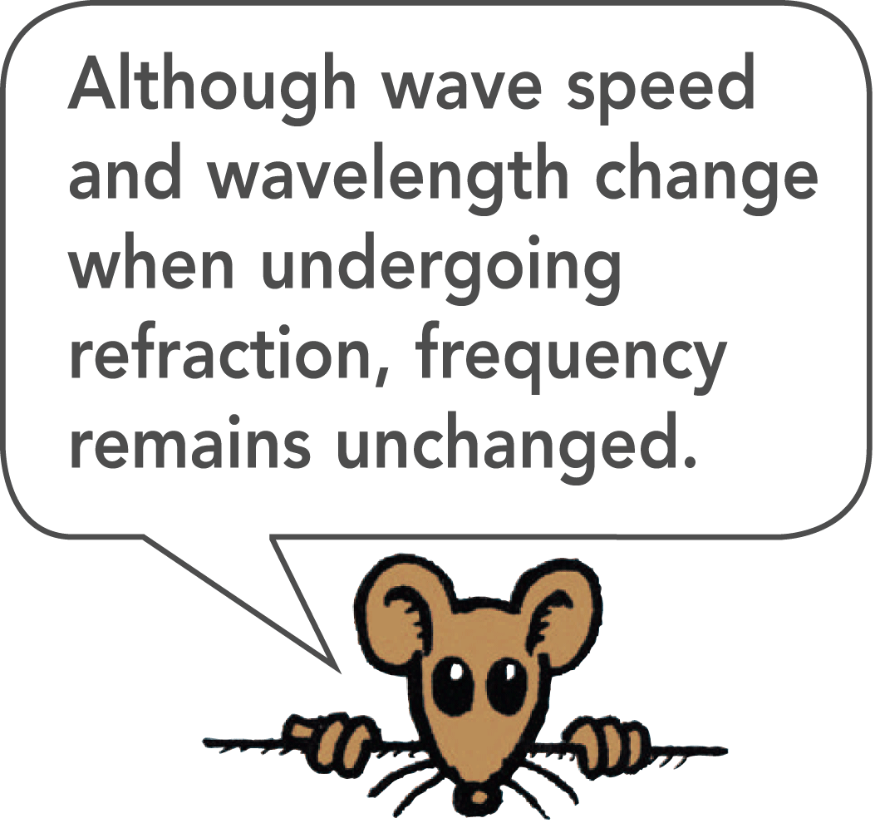
Refraction
In drawing a diagram of a wave, it is convenient to draw lines, called wave fronts, that represent the positions of different crests.
At each point along a wave front, the wave is moving perpendicular to the wave front.
The direction of motion of the wave is represented by rays that are perpendicular to the wave fronts.
Sometimes we analyze waves in terms of wave fronts, and at other times in terms of rays.

Slide 15
Refraction of Light
Changes in the speed of light as it passes from one medium to another, or variations in the temperatures and densities of the same medium, cause refraction.

Slide 16
Refraction of Light
Due to the refraction of light:
swimming pools appear shallower,
a pencil in a glass of water appears bent,
the air above a hot stove seems to shimmer, and
stars twinkle.
The directions of the light rays change because of refraction.

Slide 17
Refraction of Light
Rays and wave fronts of light refract as they pass from air into water.
Wave fronts that enter the water first are the first to slow down.
The refracted ray of light is closer to the normal than is the incident ray.

Slide 18
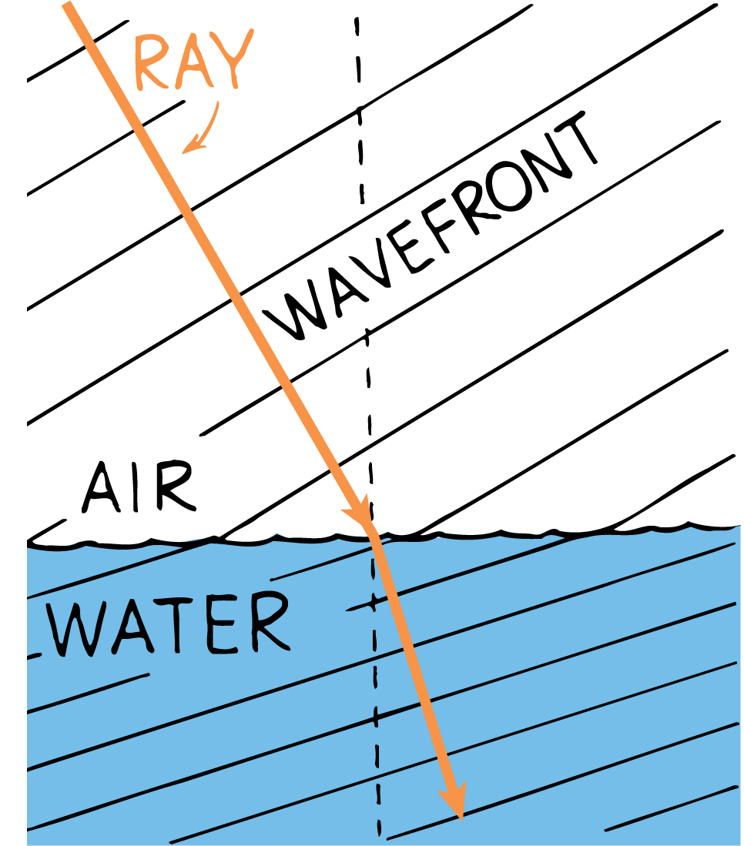
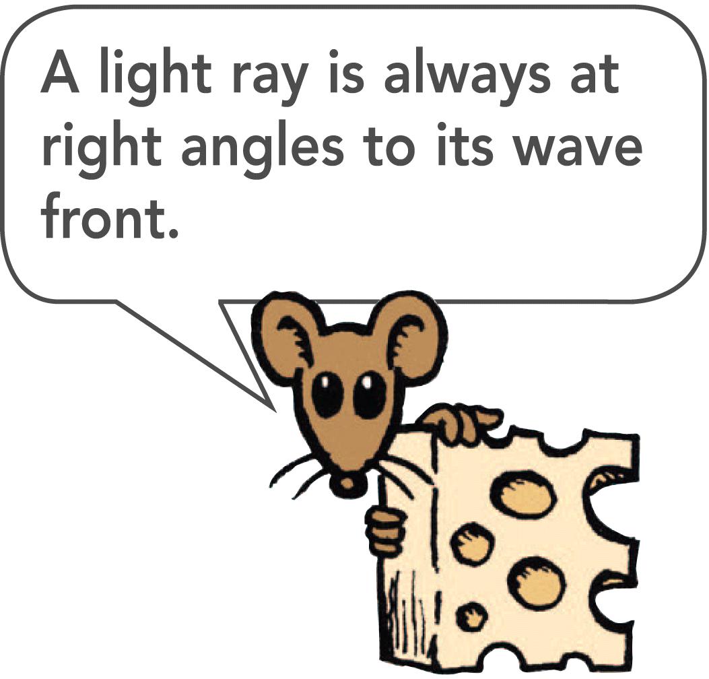
Refraction of Light
As a light wave passes from air into water, its speed decreases.

Slide 19
Refraction of Light
When light rays enter a medium in which their speed decreases, as when passing from air into water, the rays bend toward the normal.
When light rays enter a medium in which their speed increases, such as from water into air, the rays bend away from the normal.
The light paths are reversible for both reflection and refraction.
If you can see somebody in a reflective or refractive device, such as a mirror or a prism, then that person can see you by looking through the device also.

Slide 20
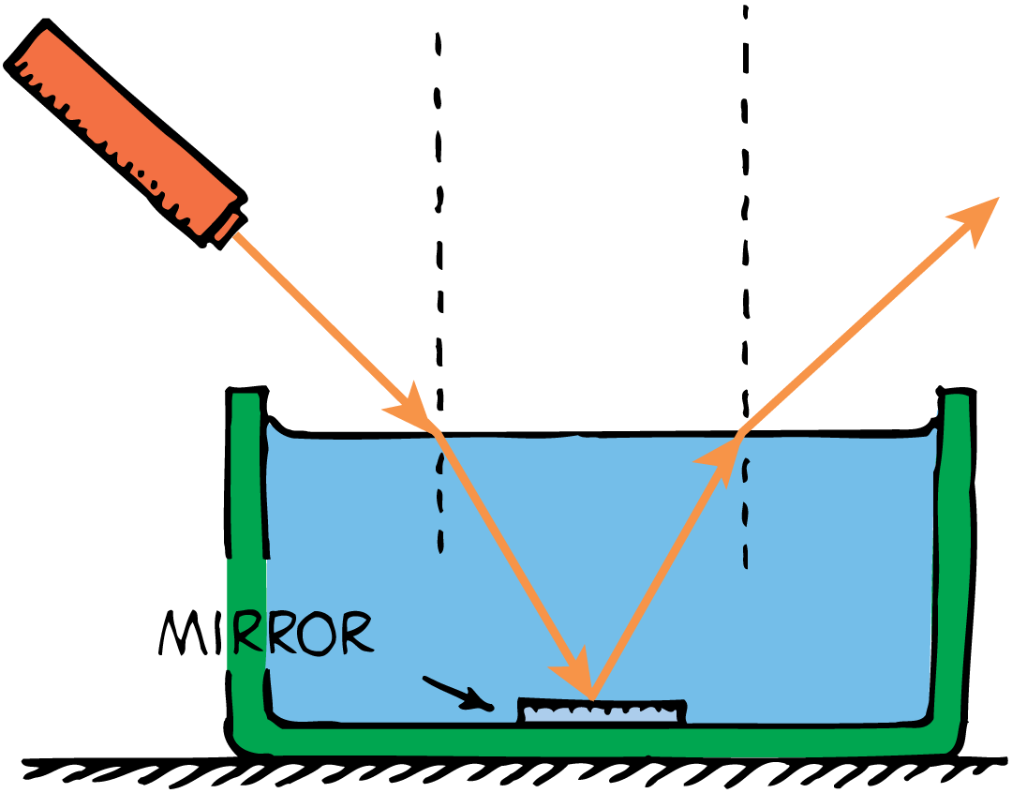
Refraction of Light
The laser beam bends toward the normal when it enters the water, and away from the normal when it leaves.

Slide 21
Dispersion in a Prism
Since different frequencies of light travel at different speeds in transparent materials, they will refract differently and bend at different angles.

Slide 22
Dispersion in a Prism
The average speed of light is less than c in a transparent medium.
How much less depends on the medium and the frequency of light.
Light of frequencies closer to the natural frequency of the electron oscillators in a medium travels more slowly in the medium.
The natural frequency of most transparent materials is in the ultraviolet part of the spectrum.
Visible light of higher frequencies travels more slowly than light of lower frequencies.

Slide 23
Dispersion in a Prism
Different frequencies of light travel at different speeds in transparent materials so they bend at different angles.
The separation of light into colors arranged according to their frequency is called dispersion.

Slide 24
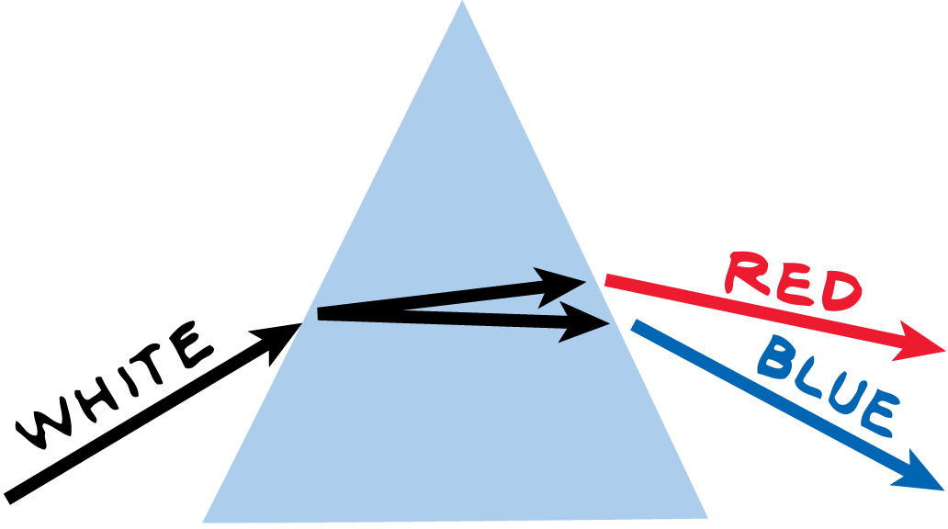
Dispersion in a Prism
Dispersion through a prism occurs because different frequencies of light travel at different speeds.

